Slide 1
Crop production analysis

Slide 2
Introduction :
Initially, loading the dataset in the jupyter notebook and importing the libraries (numpy,pandas,matplotlib,searborn.)
Cells are likely to provide a project’s objective, tackling on analyzing crop production data.
After importing , code cells read the csv file after loading crop production data.

Slide 3
Details of dataset performance
Data loading
Data cleaning
Exploratory data analysis
Statistical analysis
Modelling

Slide 4
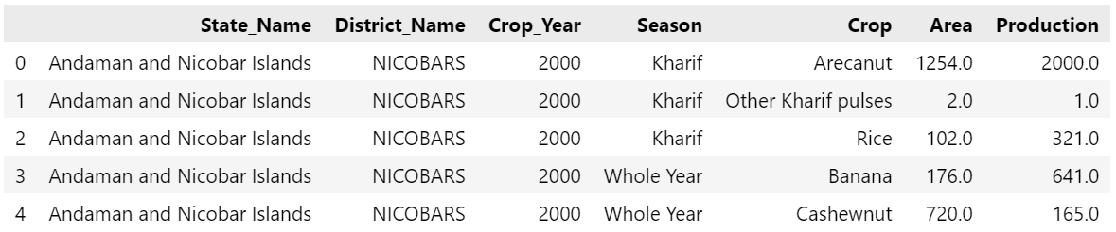
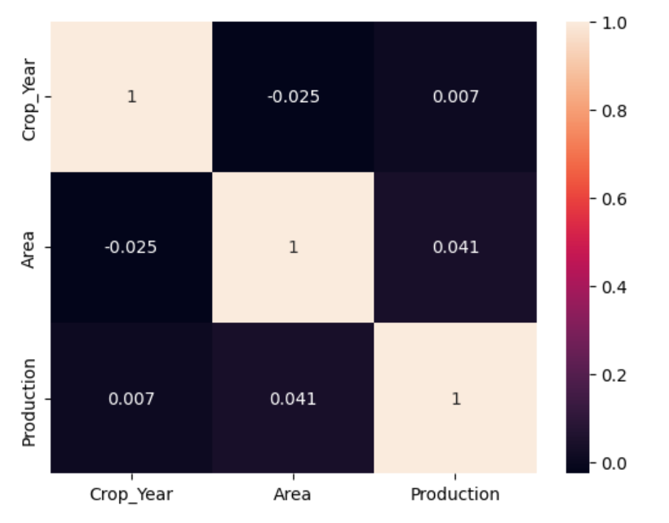
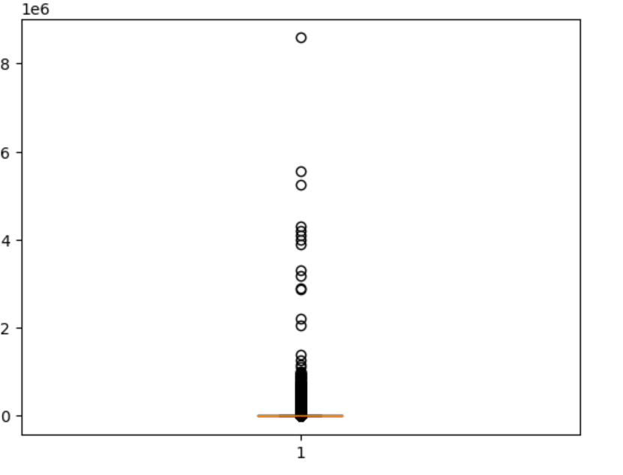
output

Slide 5
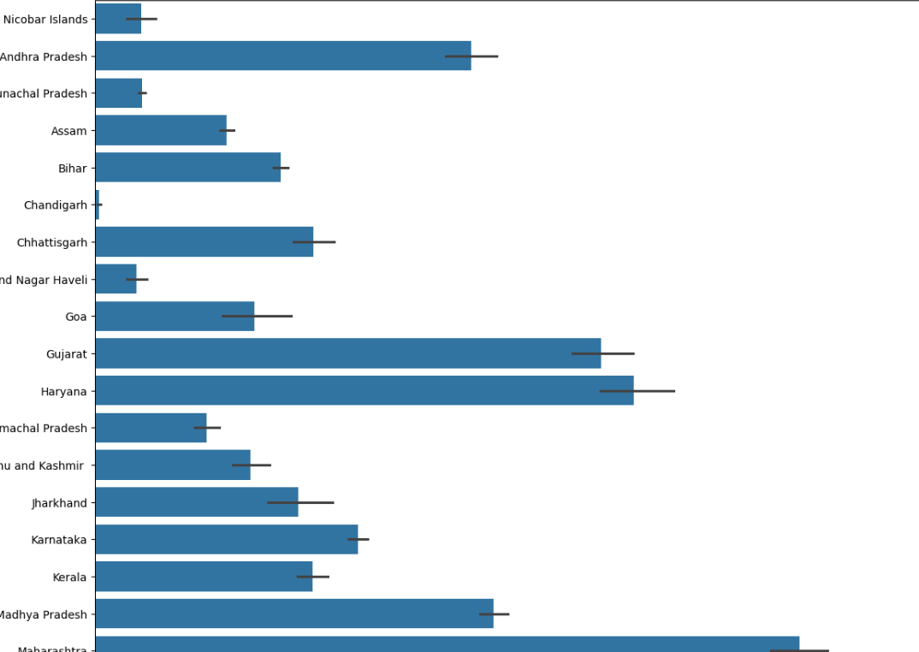
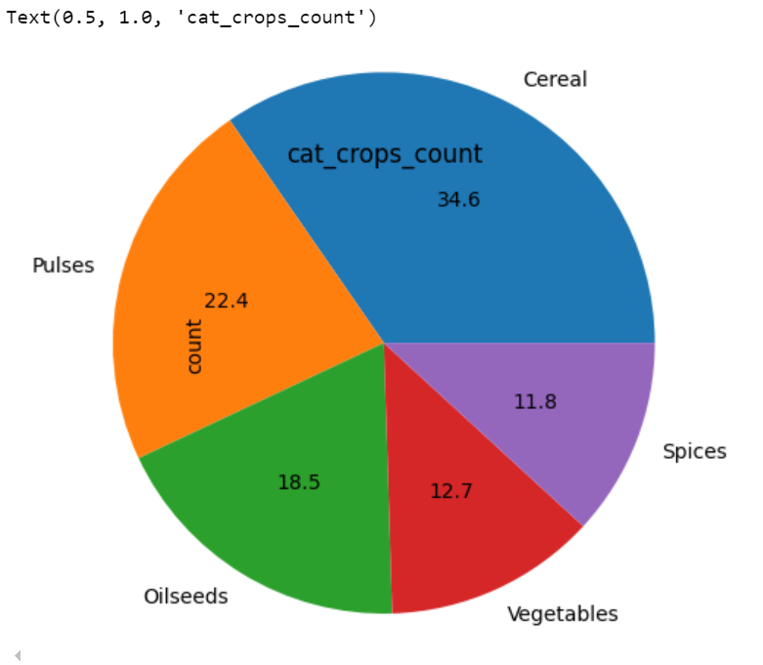
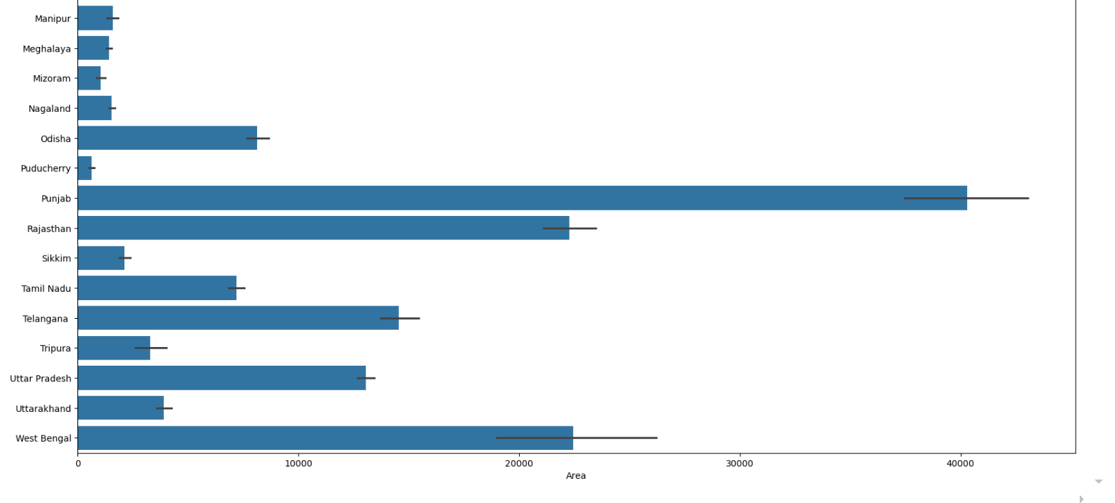
output

Slide 6
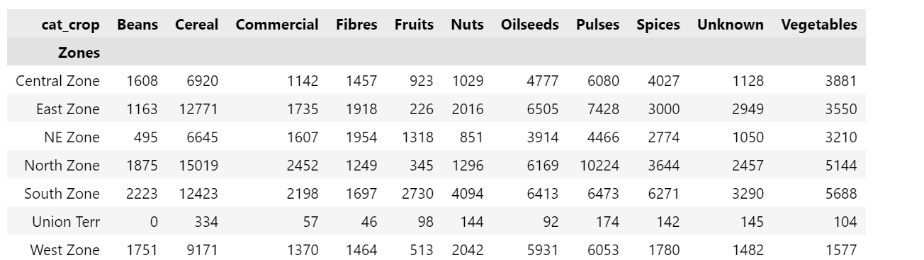
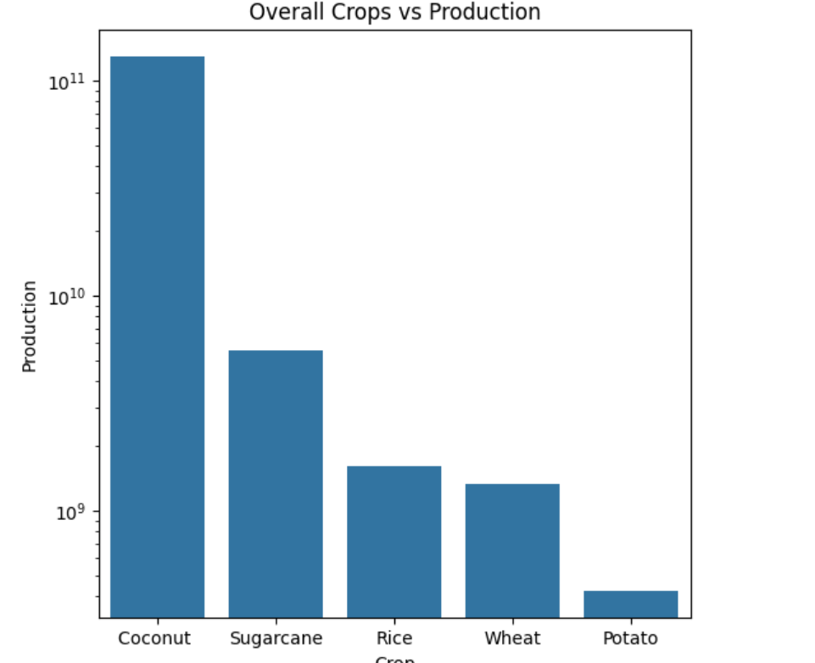
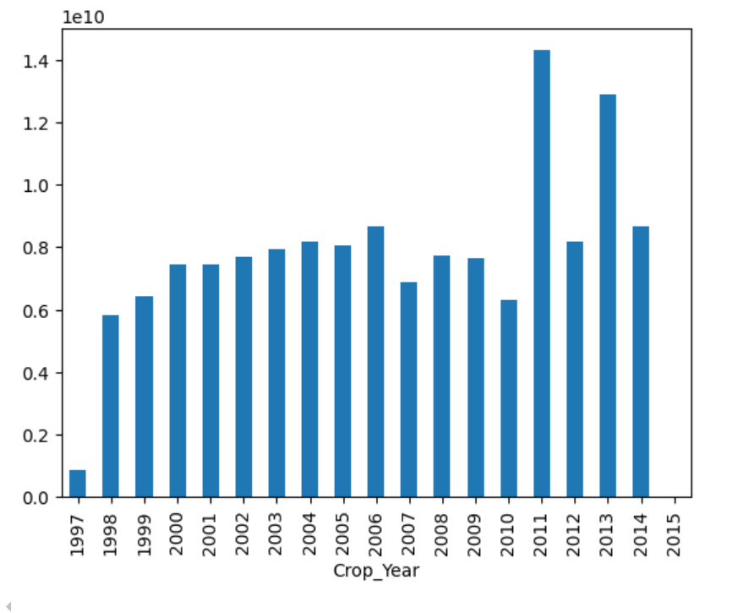
output

Slide 7
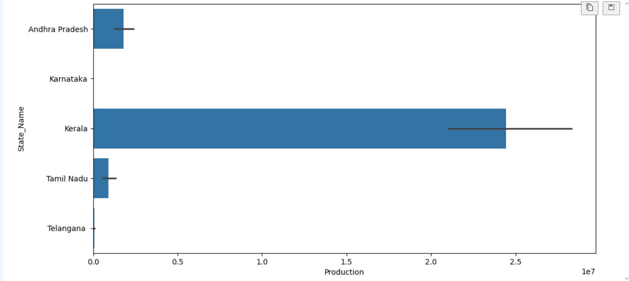

Slide 8
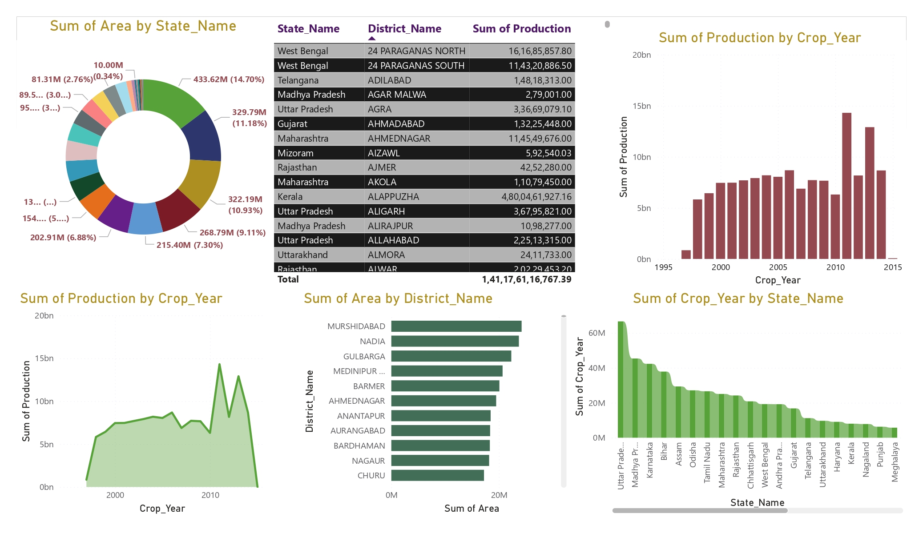
output

Slide 9
overview
Data Loading and Initial Exploration:
Load the dataset.
Display basic information and summary statistics.
Check for and handle missing values in the 'Production' column.
Data Encoding and Correlation Analysis:
Encode categorical features.
Calculate and visualize the correlation matrix using a heatmap.
Exploratory Data Analysis:
Display unique counts for states, districts, and crop years.
Visualize distributions using boxplots and bar plots.
Zone Mapping:
Map states to specific zones and visualize their distributions.
Crop Categorization:
Categorize crops into predefined categories and visualize the counts.
Production Analysis:
Analyze and visualize yearly production, production by state in the south zone, and seasonal production.
Create a crosstab of zones and crop categories.
Visualize top crop categories and overall crop production using bar plots and pie charts.

Slide 10
THANK YOU

